Slide 1

Robust analytic models for science at extreme scales
Gagan Agarwal^{1*} Prasanna Balaprakash² Ian Foster^{2*} Raj Kettimuthu² Sven Leyffer² Vitali Morozov² Todd Munson² Nagi Rao^{3*} Saday Sadayappan¹ Brad Settlemyer³ Brian Tierney^{4*} Don Towsley^{5*} Venkat Vishwanath² Yao Zhang²
¹ Ohio State University ² Argonne National Laboratory
³ Oak Ridge National Laboratory ⁴ ESnet ⁵ UMass Amherst (* Co-PIs)
♦︎
Advanced Scientific Computing Research
Program manager: Rich Carlson

Slide 2
Prediction, explanation, & optimization are challenging for even “simple” E2E workflows
Desti-nation data store
Source data store
Wide Area Network
For example, file transfer, for which we want to:
Predict achievable throughput for a specific configuration
Explain factors influencing performance
Optimize parameter values to achieve high speeds

Slide 3
Prediction, explanation, & optimization are challenging for even “simple” E2E workflows
Wide Area Network
Application
Application
OS
OS
Router
Router
TCP
TCP
IP
IP
LAN
Switch
NIC
NIC
LAN
Switch
FS Stack
FS Stack
Destination
data transfer node
HBA/HCA
HBA/HCA
Source data transfer node
OST
OSS
Storage Array
OSS
+ diverse environments
+ diverse workloads
+ contention
Lustre file system
MDS
MDT
MDS
Notes:
Yes. The entire namespace is stored on Lustre Metadata Servers (MDSs); file data is stored on Lustre Object Storage Servers (OSSs).
Note that unlike many block-based clustered filesystems where the MDS is still in charge of block allocation, the Lustre MDS is not involved in file IO in any manner and is not a source of contention for file IO.
The data for each file may reside in multiple objects on separate servers. Lustre 1.x manages these objects in a RAID-0 (striping) configuration, so each object in a multi-object file contains only a part of the file's data. Future versions of Lustre will allow the user or administrator to choose other striping methods, such as RAID-1 or RAID-5 redundancy.
What is the difference between an OST and an OSS?
As the architecture has evolved, we refined these terms.
An Object Storage Server (OSS) is a server node, running the Lustre software stack. It has one or more network interfaces and usually one or more disks.
An Object Storage Target (OST) is an interface to a single exported backend volume. It is conceptually similar to an NFS export, except that an OST does not contain a whole namespace, but rather file system objects.

Slide 4
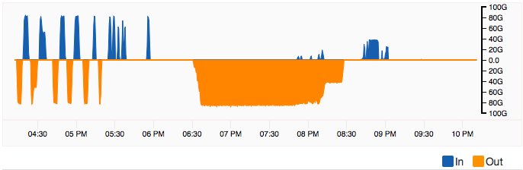
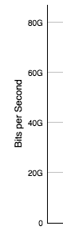
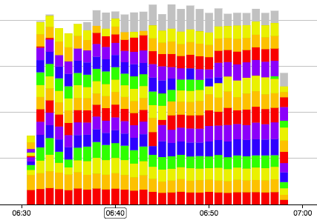
85 Gbps sustained disk-to-disk over 100 Gbps network, Ottawa—New Orleans
Raj Kettiumuthu and team, Argonne

Slide 5
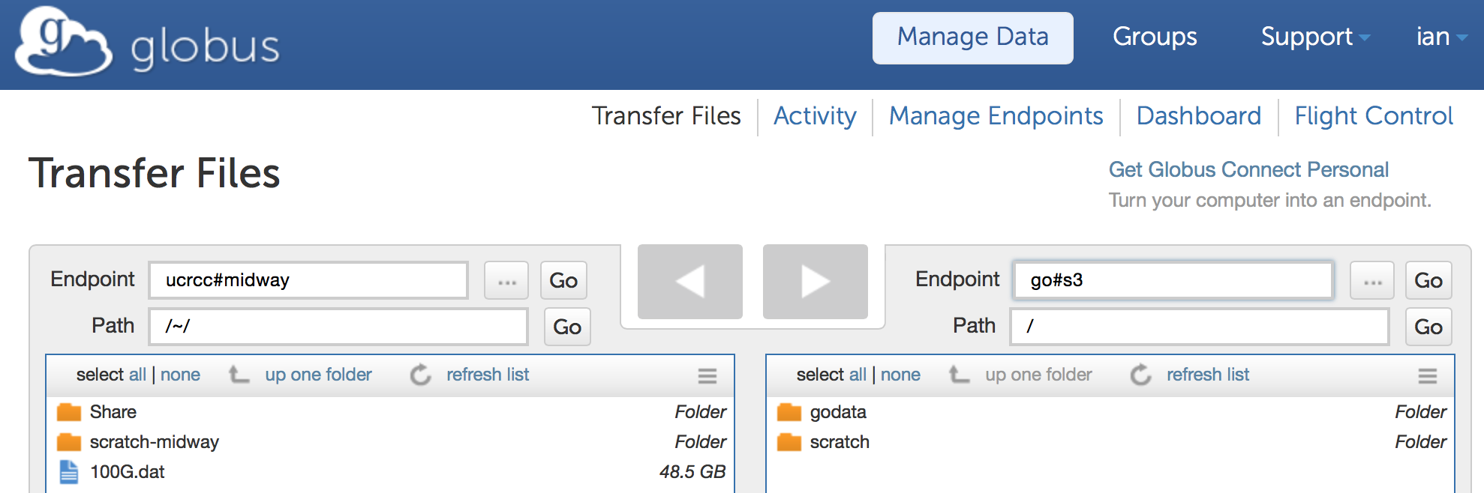
High-speed transfers to/from AWS cloud, via Globus transfer service
go#s3
UChicago → AWS S3 (US region): Sustained 2 Gbps
2 GridFTP servers, GPFS file system at UChicago
Multi-part upload via 16 concurrent HTTP connections
AWS → AWS (same region): Sustained 5 Gbps

Slide 6
One Advanced Photon Source data node: 125 destinations

Slide 7
Same node
(1 Gbps link)

Slide 8
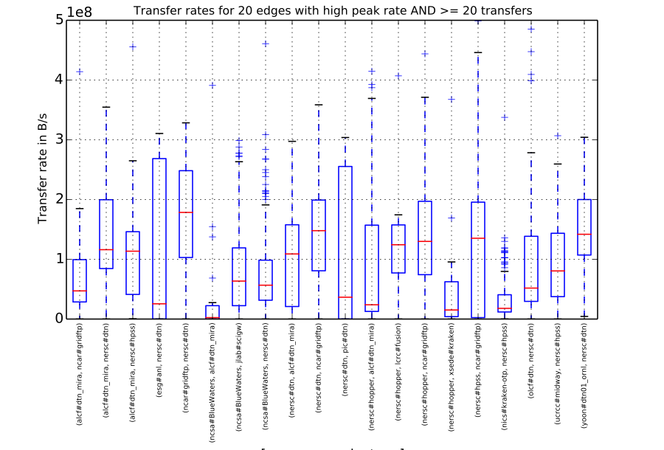

Slide 9
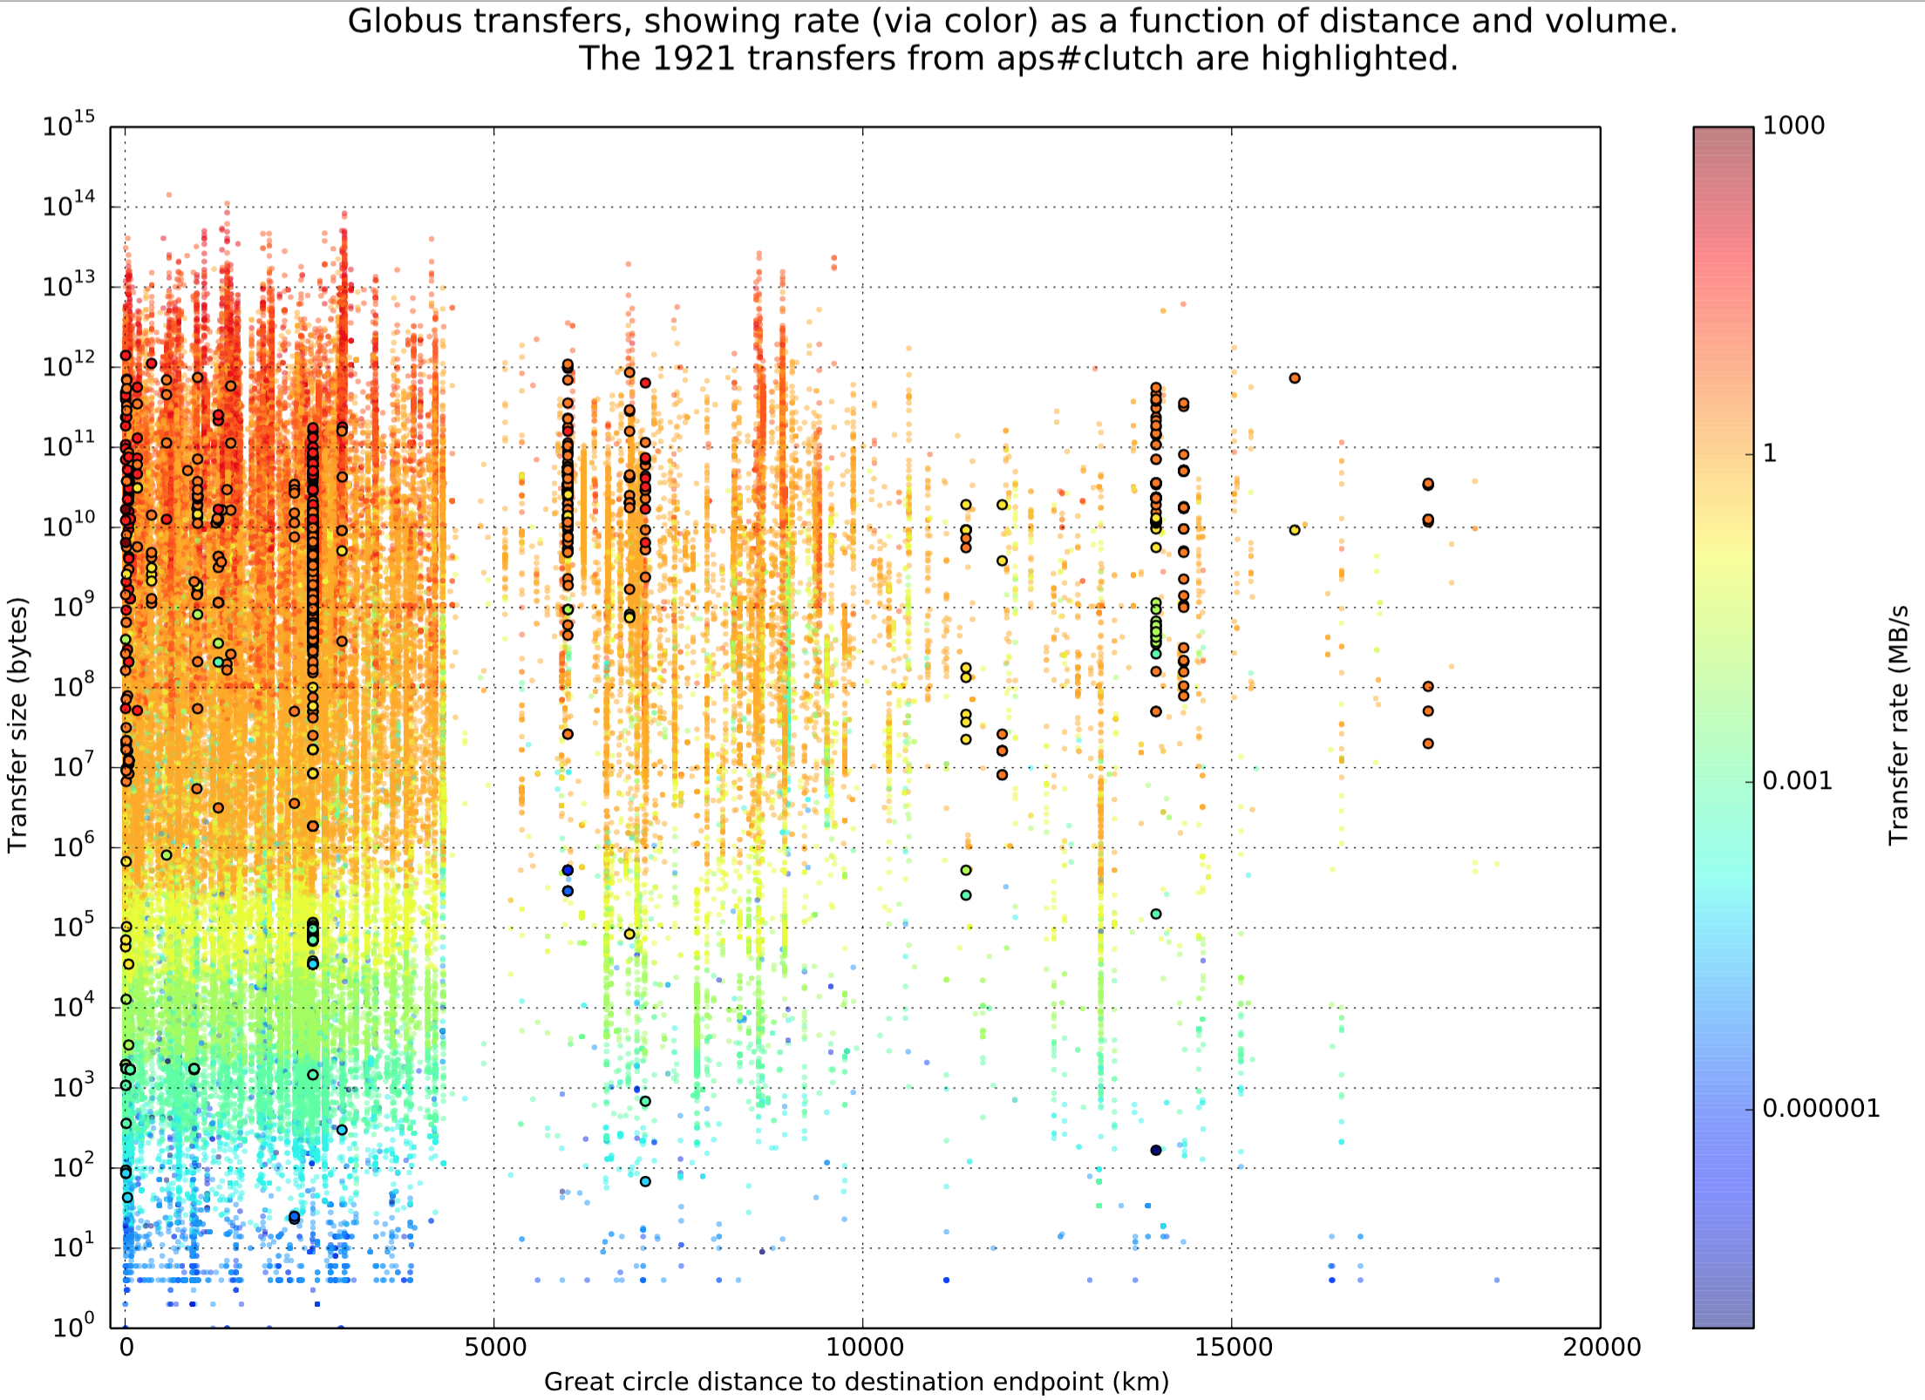

Slide 10
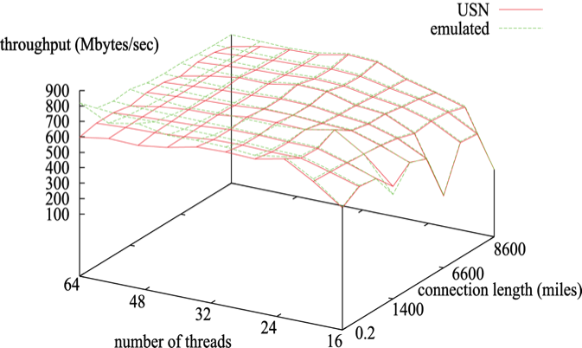
How to create more accurate, useful, and portable models of such systems?
Simple analytical model:
T= α+ β*l
[startup cost + sustained bandwidth]
Experiment + regression to estimate α, β
Data-driven modeling to learn unknown details of system & application components
Model composition
First-principles modeling to better capture details of system & application components
Model, data comparison
Notes:
Combine simulation, emulation, experiment: differential regression
First-principles models
Machine learning to

Slide 11
The RAMSES vision
To develop a new science of end-to-end analytical performance modeling that will transform understanding of the behavior of science workflows in extreme-scale science environments.
Based on integration of first-principles and data-driven modeling, and structured approach to model evaluation & composition

Slide 12
The RAMSES research agenda & platform
Modeling
Develop, evaluate, and refine component and end-to-end models
Tools
Develop easy-to-use tools to provide end-users with actionable advice
Evaluators
Advisor
Database
Estimators
Tester
Estimation
Develop and apply data-driven estimation methods: differential regression, surrogate models, etc.
Experiments
Extensive, automated experiments to test models & build database

Slide 13

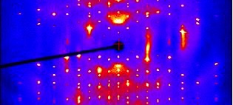

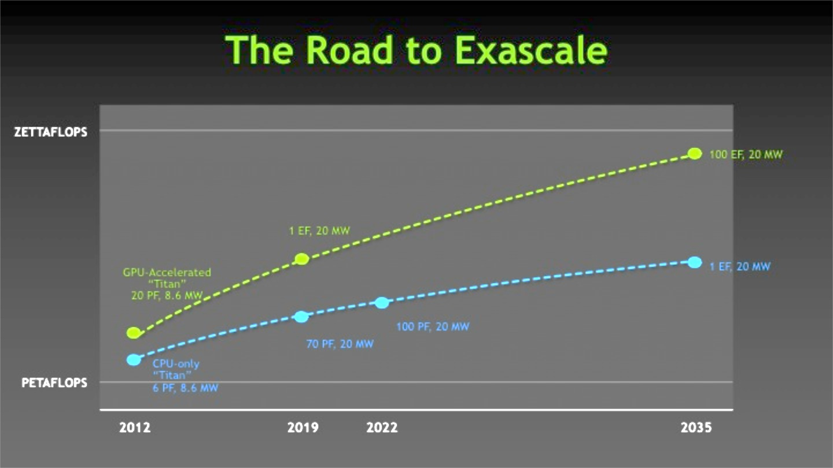
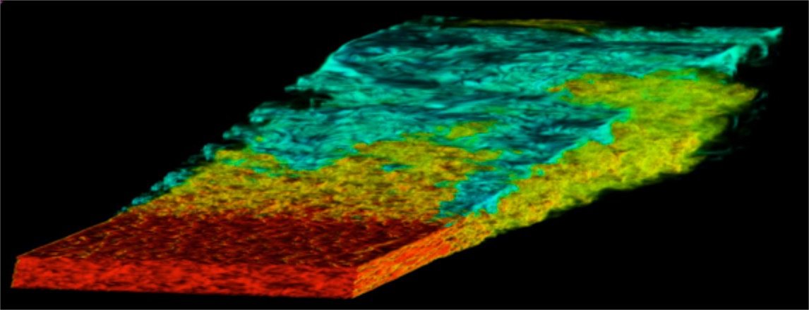
We are informed by five challenge workflows
Transfer: High-performance, end-to-end file transfer
Scattering: Capture and analysis of diffuse scattering experimental data
MapReduce: Data-intensive, distributed data analytics
Exascale: Performance of exascale application kernels on memory hierarchies
In-situ: Configuration and placement of in-situ analysis computations
Notes:
Q: I can’t work out why the bottom two images are dimmed: some configuration option?
Or, how to create nice oval around first.

Slide 14
Transfer: End-to-end file movement
Wide Area Network
Application
Application
OS
OS
Router
Router
TCP
TCP
IP
IP
LAN
Switch
NIC
NIC
LAN
Switch
FS Stack
FS Stack
Destination
data transfer node
HBA/HCA
HBA/HCA
Source data transfer node
OST
OSS
Storage Array
OSS
Lustre file system
Predict: Throughput for configuration
Explain: Factors influencing performance
Optimize: Parameters for high speeds
MDS
MDT
MDS
Notes:
Yes. The entire namespace is stored on Lustre Metadata Servers (MDSs); file data is stored on Lustre Object Storage Servers (OSSs).
Note that unlike many block-based clustered filesystems where the MDS is still in charge of block allocation, the Lustre MDS is not involved in file IO in any manner and is not a source of contention for file IO.
The data for each file may reside in multiple objects on separate servers. Lustre 1.x manages these objects in a RAID-0 (striping) configuration, so each object in a multi-object file contains only a part of the file's data. Future versions of Lustre will allow the user or administrator to choose other striping methods, such as RAID-1 or RAID-5 redundancy.
What is the difference between an OST and an OSS?
As the architecture has evolved, we refined these terms.
An Object Storage Server (OSS) is a server node, running the Lustre software stack. It has one or more network interfaces and usually one or more disks.
An Object Storage Target (OST) is an interface to a single exported backend volume. It is conceptually similar to an NFS export, except that an OST does not contain a whole namespace, but rather file system objects.

Slide 15

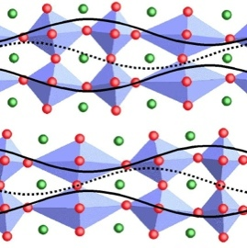
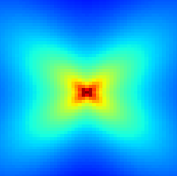
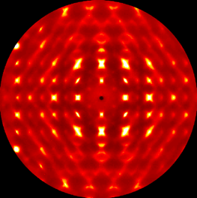
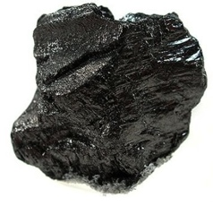

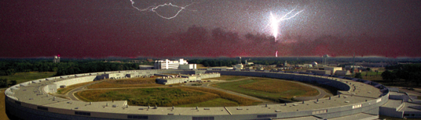
Scattering: Linking simulation and experiment to study disordered structures
Contribute to knowledge base
Knowledge base
Past experiments; simulations; literature; expert knowledge
Select experiments (mins—hours)
Simulations driven by experiments (mins—days)
Detect errors (secs—mins)
Knowledge-driven
decision making
La 60%
Sr 40%
Material composition
Simulated structure
Simulated scattering
Experimental scattering
Sample
Evolutionary optimization
Diffuse scattering images from Ray Osborn et al., Argonne
Notes:
“Most of materials science is bottlenecked by disordered structures”—Littlewood.
Solve inverse problem.
How do we make this sort of application routine? Allow thousands—millions?—to contribute to the knowledge base.
Challenge: takes months to do a single loop through cycle.
Just as important, it is an incredibly labor intensive and expensive process.

Slide 16
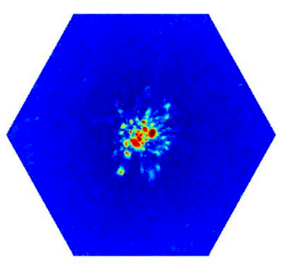
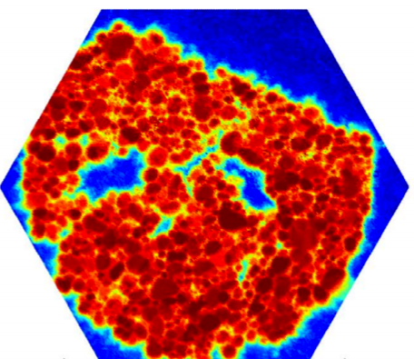
Immediate assessment of alignment quality in near-field high-energy diffraction microscopy
Before
After
Hemant Sharma, Justin Wozniak, Mike Wilde, Jon Almer
Notes:
DS, NF-HEDM, FF-HEDM, PD workflows operational
Catalog integrated into workflow, supports rich user interface
Workflows use large-scale compute resources outside of APS
Data publication service demonstrated
Parallel algs for 3-D image reconstruction, structure determination, etc.
Globus Galaxies platform integrated with Swift for scalability

Slide 17
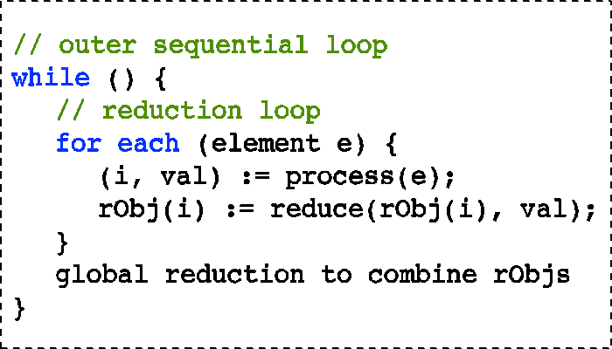
MapReduce: Distributing data and computation for data analytics
Job assignment
Global reduction
Remote data analysis
17

Slide 18
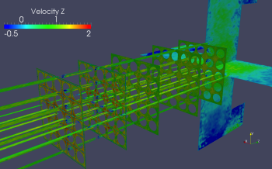
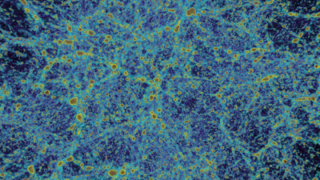
Exascale simulation
Images Courtesy: Joseph Insley (Argonne)
Nek5000 CFD
Matrix vector product phase
Conjugate gradient iteration
Communication phase involving nearest neighbor exchange and vector reductions
HACC Cosmology
Compute intensive phase with regular stride one access
Tree walk phase: irregular memory access with high branching and integer ops
3D FFT communication intensive phase
I/O Phase
Notes:
HACC:
The short force evaluation kernel is compute intensive with regular stride one memory accesses. This kernel can be fully vectorized and/or threaded.
The tree walk phase has essentially irregular indirect memory accesses, and has very high number of branching and integer operations.
The 3D FFT phase is implemented with point-to-point communication operations and is executed only every long time step; thus significantly reducing the overall communication complexity of the code.
NEKBONE KERNEL : The Nekbone Kernel is a single-core code focused on the matrix-vector product at the heart of the spectral element method. The code allows for analysis and optimization of the performance of the matrix-vector product kernel, which is recast as a set of computationally intense matrix-matrix products with relatively low operation count and minimal data movement.
NEKBONE : The Nekbone mini-app allows users to study the computationally intense linear solvers that account for a large percentage of the more intricate Nek5000 software, as well as the communication costs required for nearest-neighbor data exchanges and vector reductions. Nekbone embeds the nekbone_kernel in a conjugate gradient iteration to solve the 3D Poisson equation. Preconditioning in the current version is based on diagonal scaling, which allows for simpler code than the full multigrid structure found in Nek5000. Nekbone has been created to be easily adapted and manipulated to different platforms, communication structures, and scalability studies.

Slide 19
In situ analysis on the DOE Leadership Computing Infrastructure
Compute Resource
(Multi Petaflop,
High Radix Interconnect Dragonfly, 5D Torus)
1
3
I/O Nodes
Switch Complex
(IB)
2
Analysis Nodes/Cluster
File Server Nodes
1536
GB/s
4
DTN Nodes
Storage System
We need to perform the right computation at the right place and time, taking into account details of the simulation, resources, and analysis

Slide 20
A diverse set of components
 | Server | Parallel computer | Router | Storage system | LAN | WAN | TCP, UDT | GridFTP | File systems | GridFTP server | NECbone | HACCbone | Checksum | Encryption | MapReduce | Other apps
Transfer | Y |  | Y | Y | Y | Y | Y | Y | Y | Y |  |  | Y | Y
Scattering | Y | Y | Y | Y | Y | Y |  |  |  |  |  |  |  |  | Y | Y
Exascale | Y | Y |  | Y |  |  |  |  |  |  | Y | Y |  |  |  | Y
Distributed MapReduce | Y | Y |  | Y | Y | Y | Y |  | Y |  |  |  |  |  | Y | Y
In-Situ | Y | Y | Y | Y | Y |  | Y |  | Y |  |  |  |  |  |  | Y

Slide 21
Develop, evaluate, and refine component and end-to-end models
Models from the literature
Fluid models for network flows
SKOPE modeling system
Develop easy-to-use tools to provide end-users with actionable advice
Runtime advisor, integrated with Globus transfer system
Develop and apply data-driven estimation methods
Differential regression
Surrogate models
Other methods from literature
Automated experiments to test models and build database
Experiment design
Testbeds

Slide 22
Overview
Performance projection
SKOPE performance modeling framework
Workload input
Input
Output
Source code
Schema for suggested tranformations
Front end
SKOPE language
Bottleneck analysis
Code skeletons
User Effort
(semi-automated with a source-to-source translator)
Per-function
intermediate repr.
(Block Skeleton Trees)
Automatic
Parser
Back end
Performance projection
Hardware model
system specifications
Synthesized characteristics
Behavior modeling engine
Execution-based
intermediate repr.
(Bayesian execution tree)
Characterization
engine
Transformed
Bayesian execution tree
Transformation engine

Slide 23
Differential regression for combining data from different sources
Example of use: Predict performance on connection length L not realizable on physical infrastructure
E.g., IB-RDMA or HTCP throughput on 900-mile connection
Make multiple measurements of performance on path lengths d:
M_{s}(d): OPNET simulation
M_{E}(d): ANUE-emulated path
M_{U}(d_{i}): Real network (USN)
Compute measurement regressions on d: Ṁ_{A}(.), A∈{S, E, U}
Compute differential regressions: ∆Ṁ_{A,B}(.) = Ṁ_{A}(.) - Ṁ_{B}(.), A, B∈{S, E, U}
Apply differential regression to obtain estimates, C∈{S, E}
𝓜_{U}(d) = M_{C}(d) - ∆Ṁ_{C,U}(d)
simulated/emulated measurements
point regression estimate

Slide 24
We will extend the differential regression method in several areas
To compare different component models
E.g., different models of network elements, storage systems, protocol implementations
To compare different composite models
E.g., different methods for combining memory and CPU models
To compare model outputs with measurements

Slide 25
Component model
cost terms
Analytical and empirical models
component
i
performance
quality model
System
parameters
Task size
parameters
Experiment design (active learning)
is a regression
estimate of

Slide 26
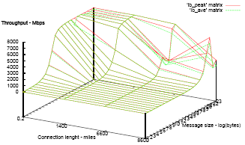
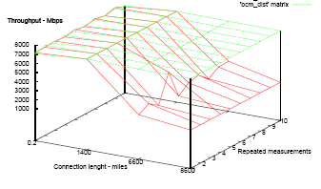
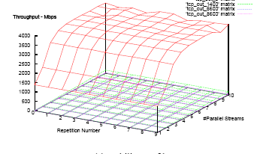
End-to-end profile composition
Source LAN
profile
WAN profile
Destination LAN
profile
Configuration for WAN devices
Configuration for
host and edge devices
Configuration for
host and edge devices
composition
operations

Slide 27
End-to-end model composition & analysis
End-to-end model using composition
It is an approximation: due to component interactions not modelled by the composition operator
Actual end-to-end performance model
Component models are “corrected” to account for un-modelled effects: this form is assumed to exist

Slide 28
Using end-to-end measurements and differential regression to correct regression estimates
Regression estimate of composed model:
“Estimated”, since components models are “incomplete” as derived from first principles and/or measurements
Error due to regression estimate:
Error can be mitigated using measurements: Corrected estimate of :
Analytical model
Correction from differential regression using
measurements

Slide 29
Performance guarantees
Vapnik-Chervonenkis theory: under finite VC-dim(F)
Guarantees that error of regression estimate is close to optimal with a certain probability
Distribution-free: does not require detailed knowledge of error distributions – uses end-to-end measurements
Error of the corrected estimate:
Estimated
Optimal

Slide 30
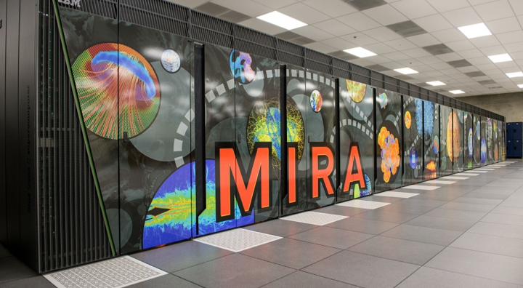
Surrogate modeling framework to inform choice of experiments
First-principles models
Machine learning & optimization
Performance metrics
Informative configurations
Evaluation

Slide 31
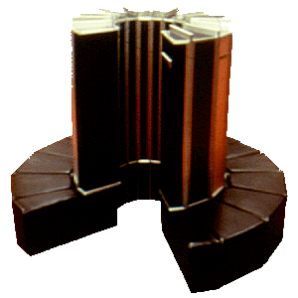
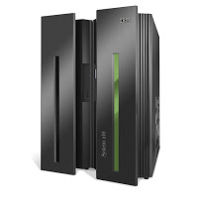
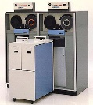
Fluid models of network flows
GridFTP flow i, parallelism k_{i}
Bottleneck router
Solve for throughputs, and transfer delays
Special case: known p
GridFTP flow i: RTT R_{i} Throughput T_{i}
Bottleneck router:
Capacity C
Loss rate p

Slide 32
Our
multi-modal approach
Performance projections
System models (current or future)
Application behavior models
SKOPE
Model composition
Code skeletons
Analytical models
Regression
models
SKOPE language
Experiments
Historical logs
Workload parameters
Source code
Benchmarks
Emulators
Simulators

Slide 33
Application to file transfer
File transfer performance projections
System models
Application behavior models
SKOPE
Storage, TCP, WAN
Model composition
Code skeletons
Analytical models
Regression
models
SKOPE language
Experiments
Historical logs
Workload parameters
Source code
iperf
GridFTP
Emulators
XDD

Slide 34
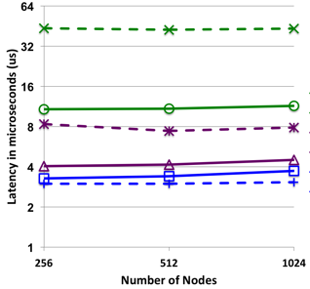
Application to exascale simulation
Exascale simulation perf. projections
System models
Application behavior models
Compute, memory, interconnect
SKOPE
Model composition
Code skeletons
Analytical models
Regression
models
SKOPE language
Experiments
Historical logs
Workload parameters
Source code
MPI benchmarks
Stream
DGEMM
IOR

Slide 35
A performance database
We aim to collect instrumentation data in a central database to simplify model validation
We plan to use the perfSONAR measurement archive tool as a starting point
REST API on top of Cassandra and Postgres
Optimized for time series data
Will extend as needed
http://software.es.net/esmond/

Slide 36
Application to transfer optimization

Slide 37
Summary
We focus on the science of modeling: integration of first-principles and data-driven models; model composition and evaluation
Our challenge applications span a broad spectrum of DOE resources and disciplines
We see big opportunities for cooperation: e.g., on development and evaluation of component models
www.ramsesproject.org [soon!]

Slide 38
Thanks, and for more information
Thanks to our sponsors:
Advanced Scientific Computing Research
Program manager: Rich Carlson
Thanks to my RAMSES project co-participants
For more information, please see https://sites.google.com/site/ramsesdoeproject/
ianfoster.org and @ianfoster

